Slide 1

FIFTEEN PUZZLE
By :
Vineeth Kumar Chandha
Sumanth Gaddam

Slide 2
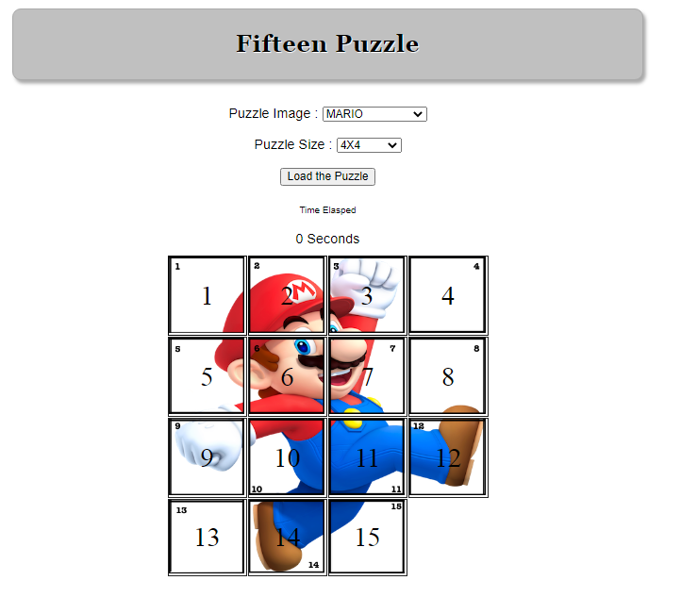
Problem
FIFTEEN PUZZLE

Slide 3
HTML
CSS
JAVASCRIPT
CSS ANIMATIONS
Technologies
Used

Slide 4

Home Page GUI

Slide 5
Home Page
Features
MULTIPLE BACKGROUNDS
DIFFERENT PUZZLE SIZES

Slide 6
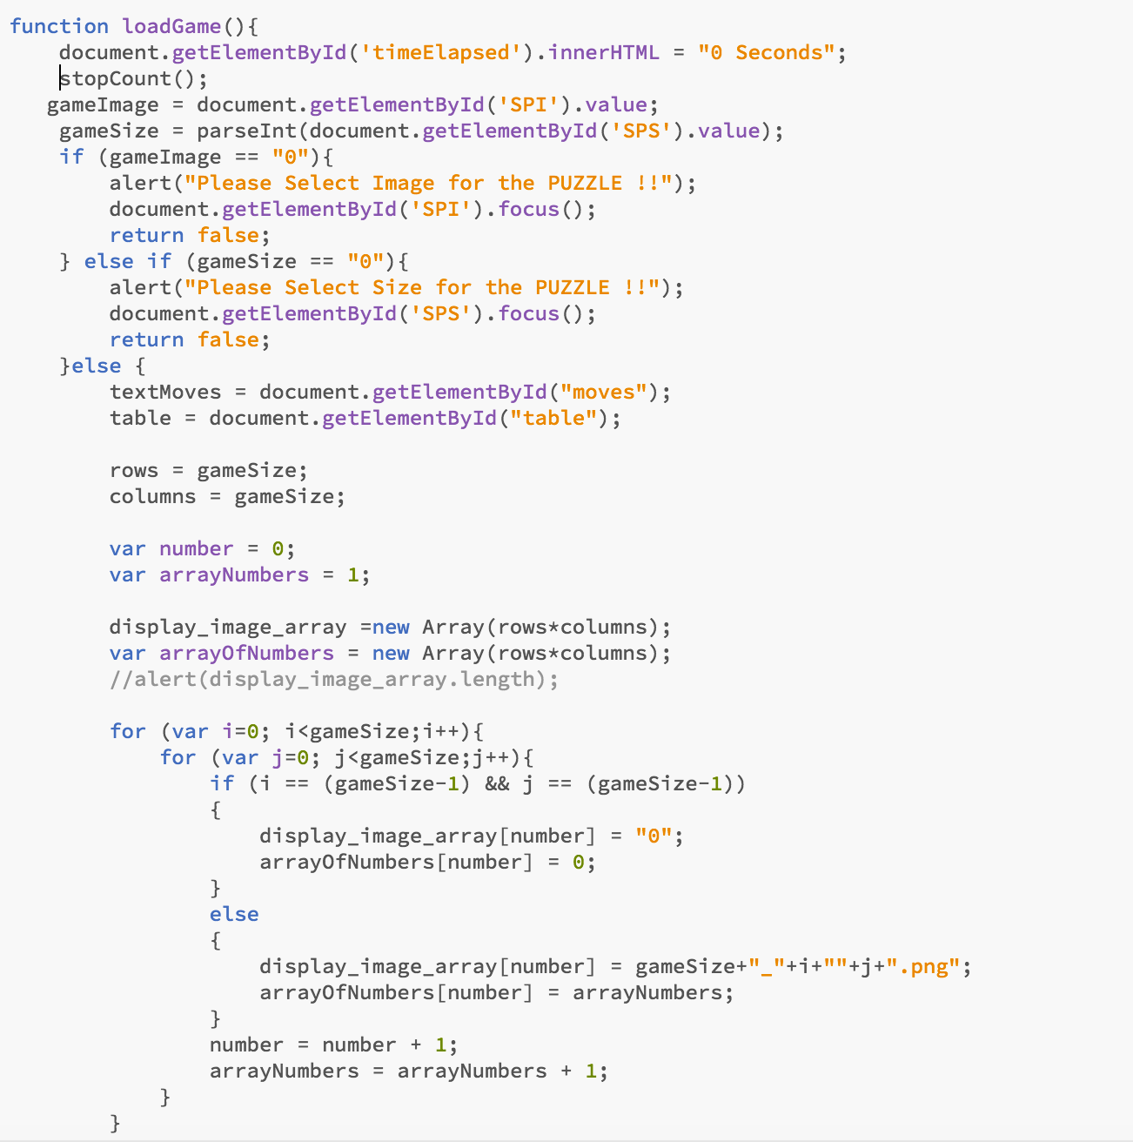
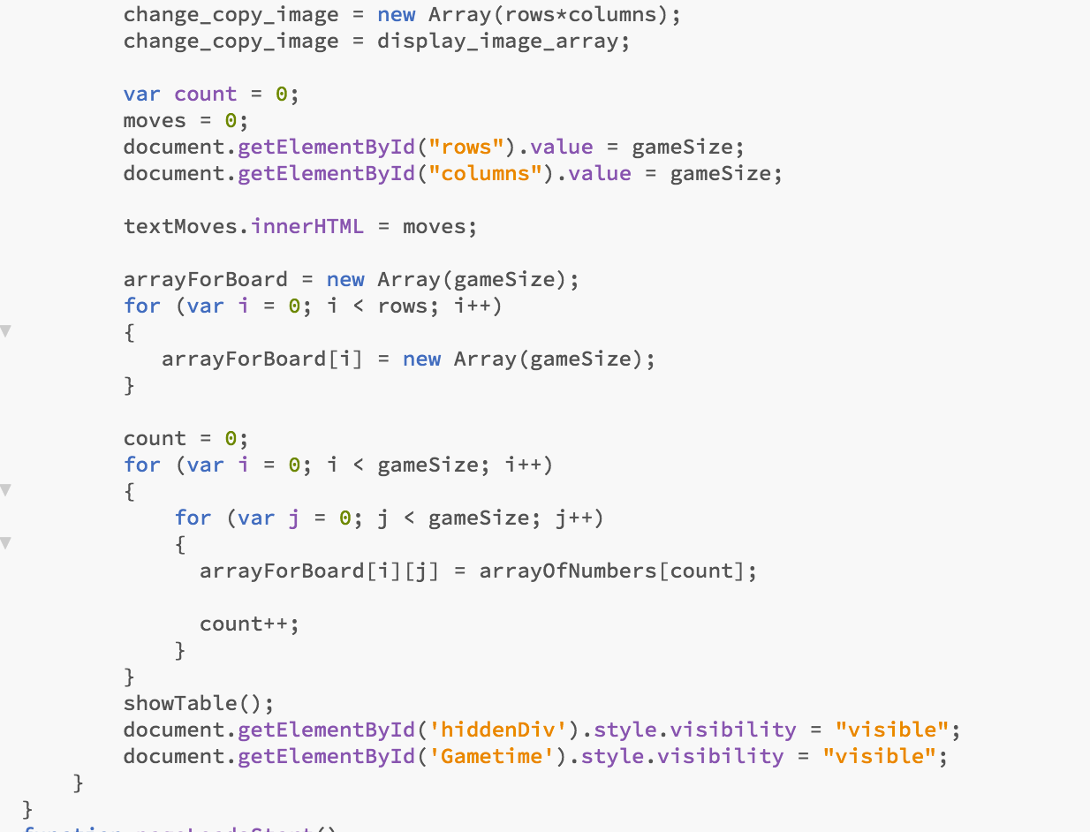
JavaScript code to load images and generate numbers

Slide 7
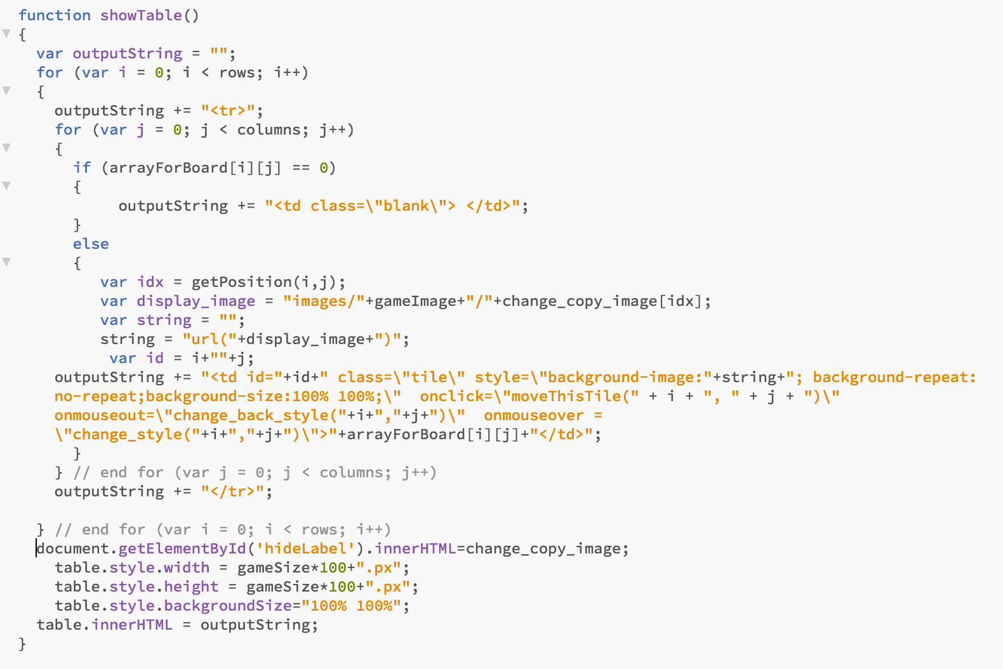
Display puzzle table

Slide 8
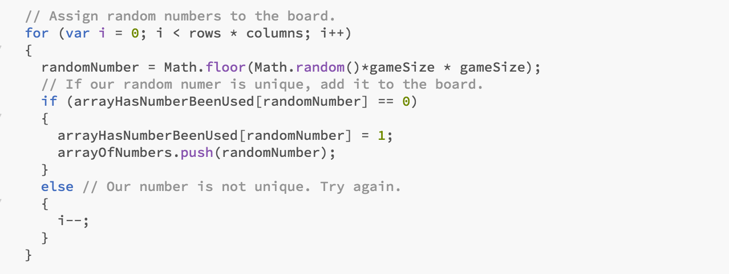
Assign random numbers to the game board

Slide 9
Have done CSS animation for the tile which will move and change the border and other style property.
CSS animation, done fading for infinite time until we move the tile.
Triggering that through the JavaScript.

Slide 10
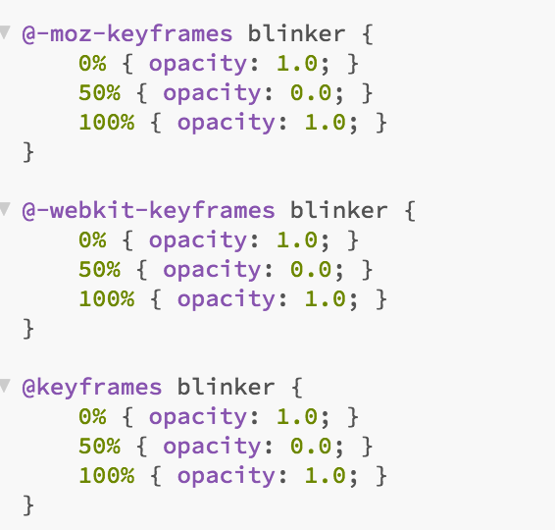
CSS Animation

Slide 11
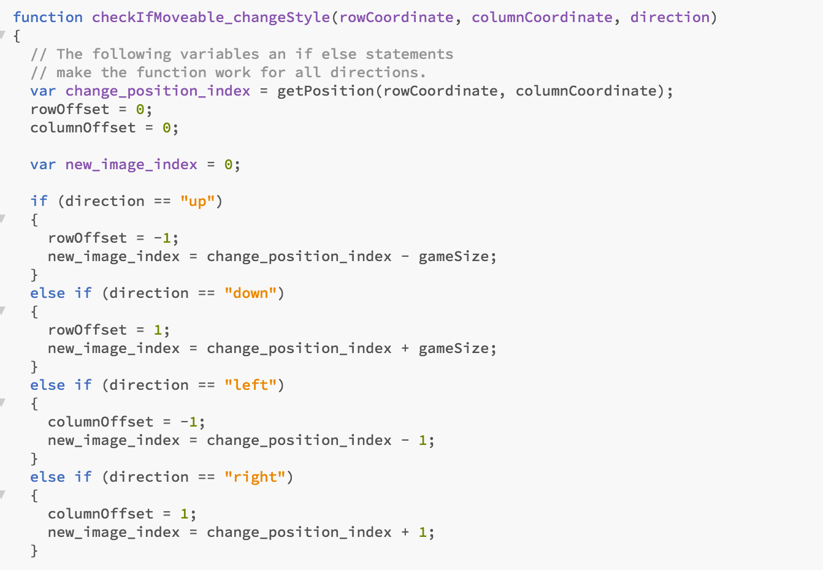
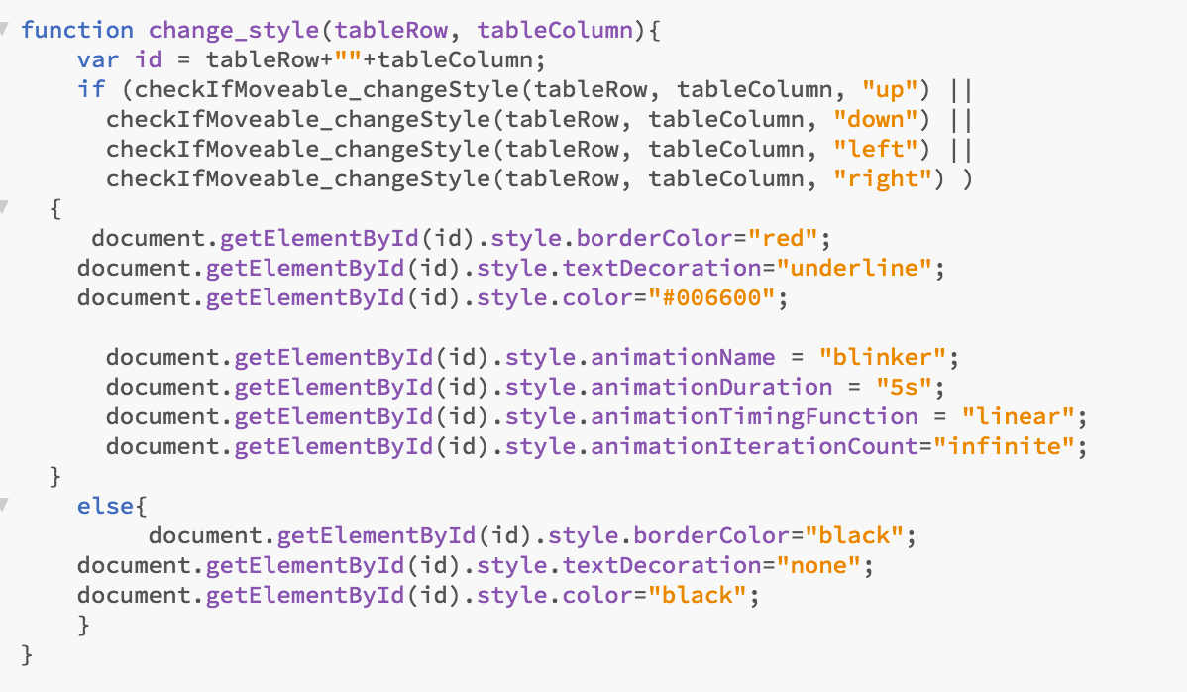
CODE FOR MOVING TILE AND CHANGING CSS

Slide 12
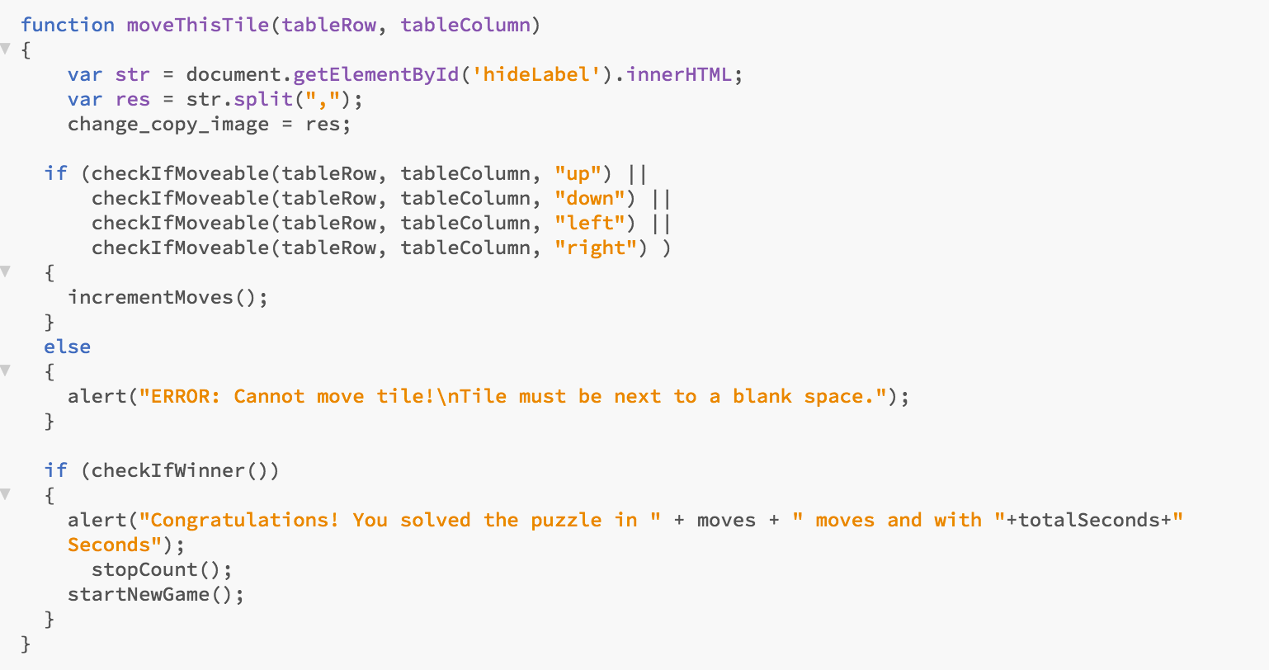

Slide 13
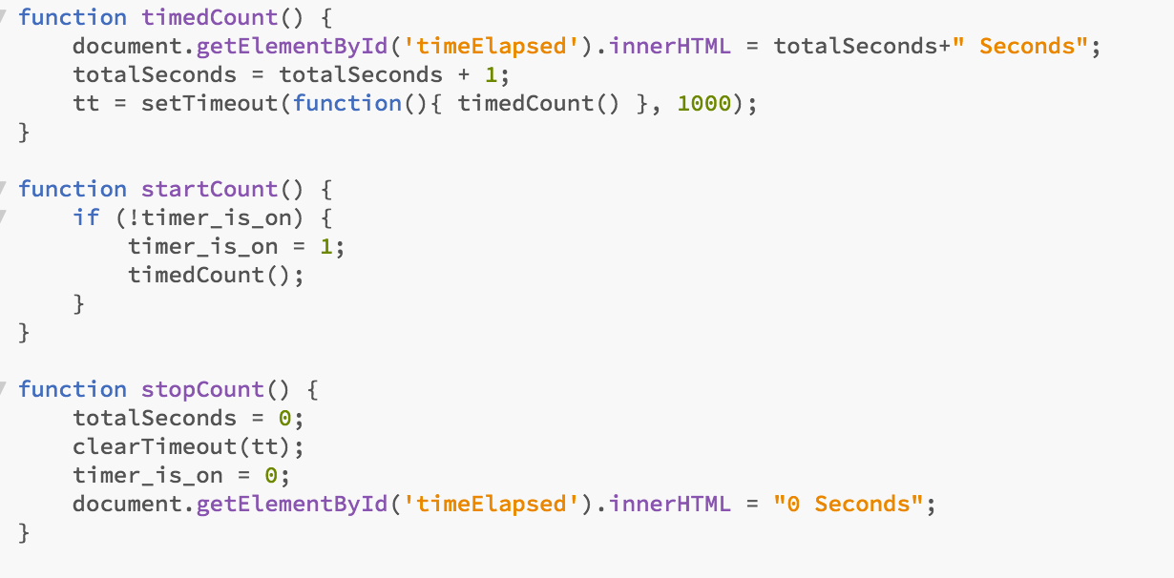
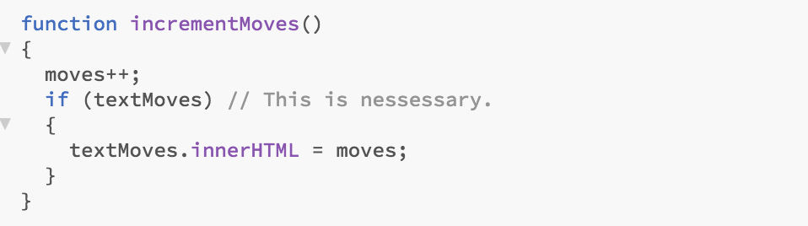
Functions to calculate time and no of moves

Slide 14
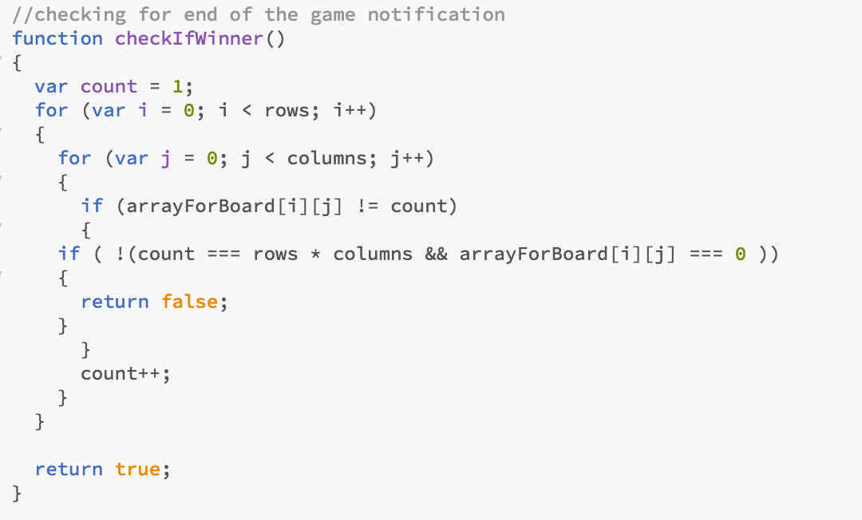
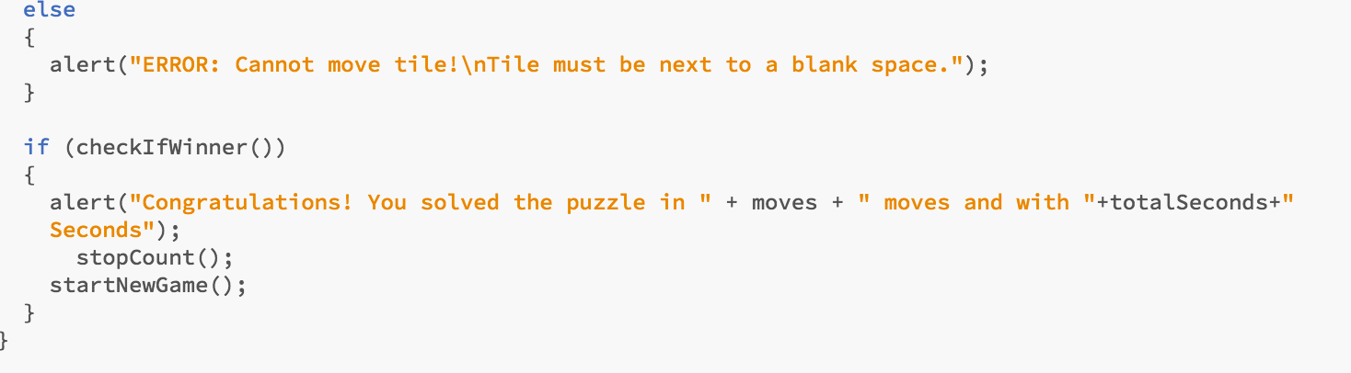

Slide 15
Multiple Backgrounds
Features
Different puzzle sizes
Animations and transitions
End of game notification
Game time

Slide 16

THANK YOU

